Slide 1
Buckingham Palace

Slide 2
General information
Buckingham Palace is the official residence of the British monarch. It is located in the park of St. James between the green park and the private gardens of the Queen of Great Britain. It was built in 1705 as the seat of the city of the Duke of London. Currently, the palace is the seat of the royal family. It is also a place where state ceremonies and official meetings of representatives, heads of state are held. Buckingham Palace is an elegant and sophisticated symbol of London.

Slide 3
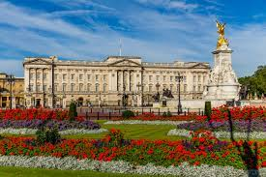
Surface
Buckingham Palace is described as a small, well-functioning town.
The total area is 77,000 m². The largest hall of the building is the Great Ballroom. It is 36.6 m long, 18 m wide and 13.5 m high. Since 1992, people from the outside can see some of the representative chambers

Slide 4
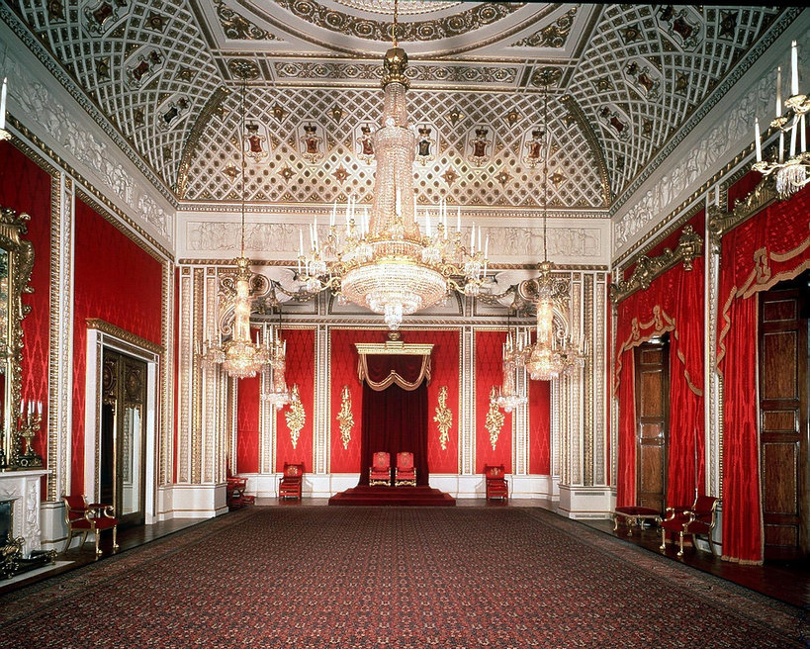
Interior of the palace
Buckingham Palace has 775 rooms. This impressive number includes both royal and guest bedrooms, offices, rooms for employees, as well as rooms used for state administration purposes. But only one of them is so important. The most important place in the entire palace is room 1844. It is in this unique room that St. In memory of Queen Elizabeth II, she gave Christmas messages and received the most important guests. Now her son, King Charles III, has taken over these duties.

Slide 5
Triva
There are 1,514 doors and 760 windows in the palace. The windows are washed every six weeks.
Edward Jones, known as "Boy Jones", broke into the palace three times between 1838 and 1841. After his first break-in, at the age of 14, he was caught by the police
Although Buckingham Palace is the private residence of the British monarch, in August and September, when the Queen is on holiday, some of the apartments can be visited
Pałac Buckingham to największy pałac na świecie

Slide 6
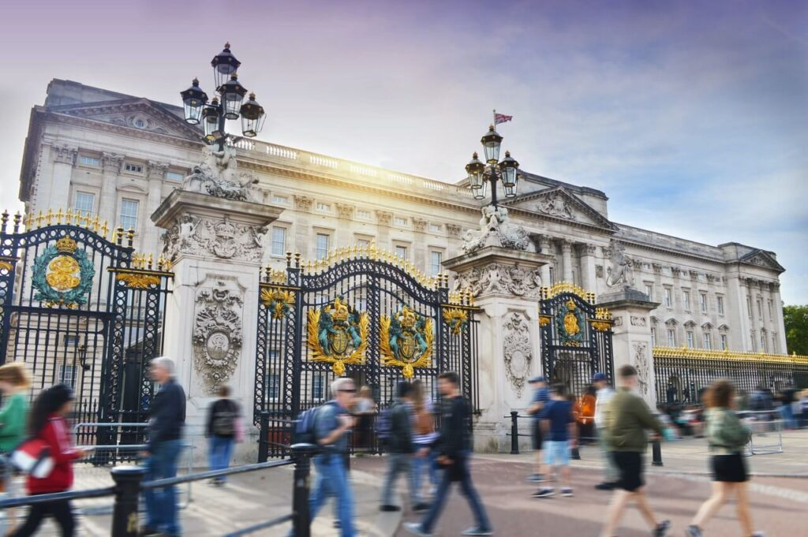
Visiting the castle
A regular ticket for the Buckingham Palace visit is £30, a youth ticket for 18-24 year olds is £19.50, a child ticket is £16.50. The same as tickets for the disa
What can you visit in the palace?
changing of the guard
State rooms
Royal Seagulls
Queen's Gallery
Clarence's house
Green park
Buckingham Palace Gardens
Home Cavalry Museum
Elizabeth || Monument
Guardian Museum

Slide 7
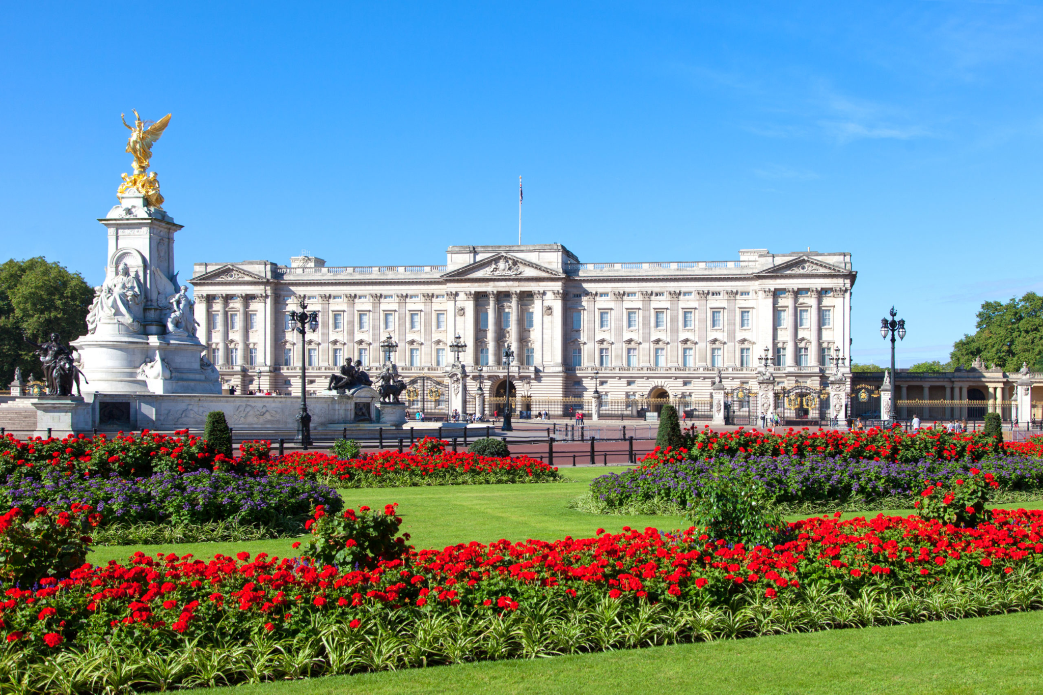
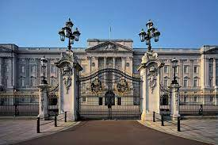
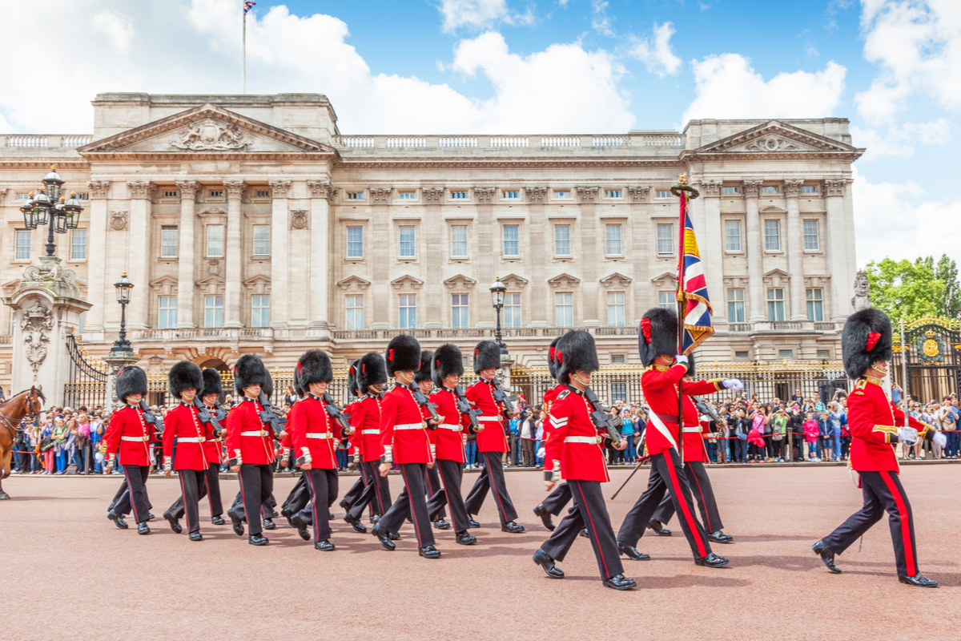
Summary
General information
Surface
Palace interior
Interesting facts
Sightseeing

Slide 8
The end
Pola Krechel

