Slide 1
EducationAL System in the usa
Emiliia Loboda
Rayana Kurbanova

Slide 2
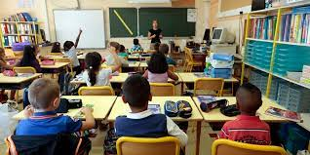
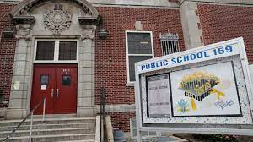
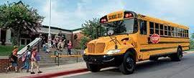
PUBLIC SCHOOL
Every child gets free education at a public school.
Public school buses are provided by government funding to help students get to school.

Slide 3
But there is also Private Education!
Boarding Schools:
Eat, sleep, and study at the school
Scholarships available
Private Schools:
Can have academic specialties
Can provide a higher level of education than a public school
Home School:
They study at home, but still have to follow the program of studies

Slide 4
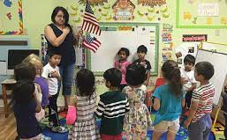
Pre-School
Children ages 1-4 go to pre-school
Not mandatory

Slide 5
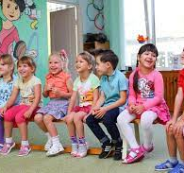
Kindergarten
Ages 5-6
First year of school that is mandatory for all children living in the USA.

Slide 6
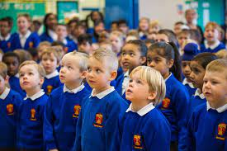
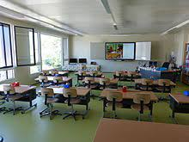
Elementary School/ Primary School
Grades 1-5
1 st year of primary school is technically
2 nd year of education but we call it 1 st grade.
School schedules are set for students.

Slide 7
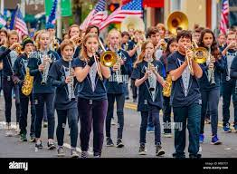
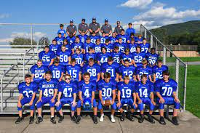
Junior High/ Middle School
Grades 6-8
Students start to pick elective classes.
Some schools have sports teams, bands, and theater.

Slide 8
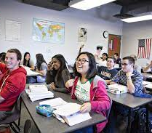
Secondary School/ High School
Grades 9-12
Students have some choice in classes
At large schools classes are separated according to the level of the students.
Every 12 th grade student must pass the “Exit Exam”, a test to graduate.

Slide 9
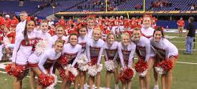
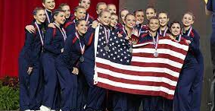
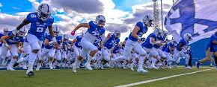
After-school activities in the Secondary School
Elective courses are offered and students can be selected in for the student government and yearbook.
Most students participate in after school activities:
Sports teams
Music (School Band)
Theater
Dance

Slide 10
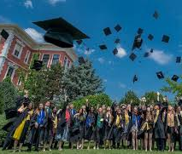
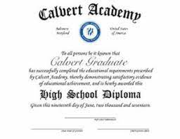
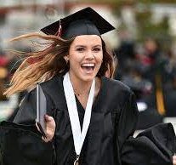
Graduation! Traditions
Students wear cap and gowns
The highest-ranking academic student usually gives a speech.
Diplomas are distributed

Slide 11
Applying to Colleges (universities) University is the same thing as College in the USA!
Students usually apply in the Fall of their 12 th grade and find out if they are accepted in March.
Grade point average shows performance from school.

Slide 12
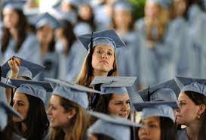
Undergraduate Education Types of Degrees
Associates Degree: 2 years long Can focus in a specific trade but many used it as a stepping tool to get into a good university
Bachelors Degree 4 years long and has a specialty

Slide 13
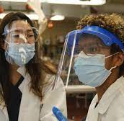
And Afterwards…
Students are prepared for to enter a profession!

