Slide 1
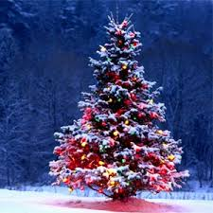
Christmas Presentation
Daria Konieczna
5a

Slide 2
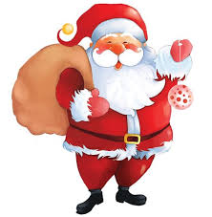
Santa Claus
he is the one who gives children presents

Slide 3
Christmas tree
we decorate this tree in december

Slide 4
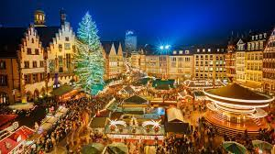
Christmas market
it usually opens in early December.

Slide 5
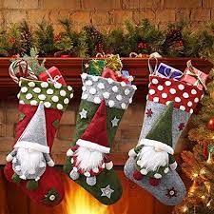
Christmas socks
we put them on the fireplace in the evening, and at night Santa puts presents in them

Slide 6
gifts
We get them when we've been good all year!

Slide 7
Advent calendar
every day for 24 days we open one window from the calendar

Slide 8
Thank you!
Merry christmas everyone

Slide 9
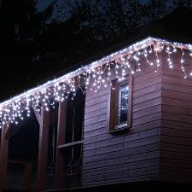
Christmas lights
we hang them wherever we want!

