Slide 1
PHONICS AND SPELLING
anglický jazyk – 9. ročník
Mgr. Daniela Vallušová

Slide 2
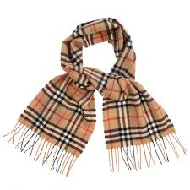
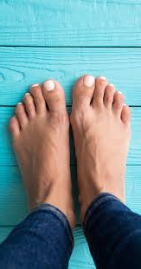
VOCABULARY – SLOVNÍČEK
flamingo - plameniak
scarf - šál
feet -nohy
Ak máš možnosť, vypočuj si online na stránke.
https://www.youtube.com/watch?v=eiEwt98HX-w

Slide 3
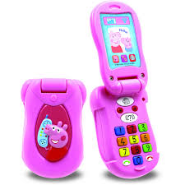
VOCABULARY- SLOVNÍČEK
phone - telefón
nephew - synovec
alphabet - abeceda
Ak máš možnosť, vypočuj si online na stránke.
https://www.youtube.com/watch?v=eiEwt98HX-w

Slide 4
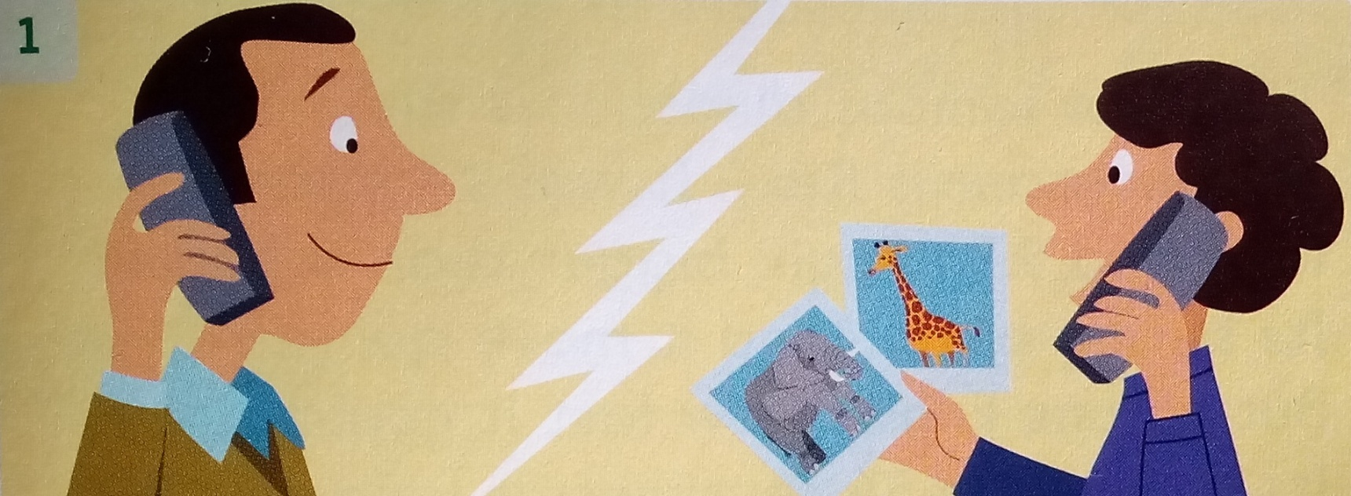
LISTEN AND READ
Yesterday an uncle and his nephew went to the zoo together.
Now they are talking on the phone about the animals.
They saw elephants, giraffes, flamingos and fish.
They took lots of photos. They had a good time.
Ak máš možnosť, vypočuj si online na stránke.
https://www.youtube.com/watch?v=eiEwt98HX-w

Slide 5
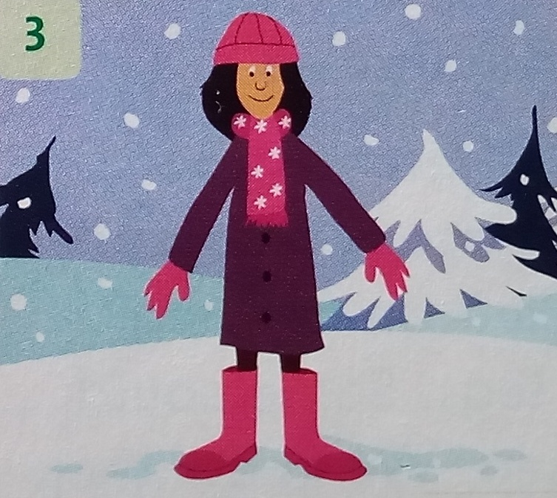
There are 26 letters in the English alphabet.
Five are vowels.
Can you say your alphabet?
When it´s cold I wear a hat and a scarf,
and on my feet I wear boots.
Ak máš možnosť, vypočuj si online na stránke.
https://www.youtube.com/watch?v=eiEwt98HX-w

Slide 6
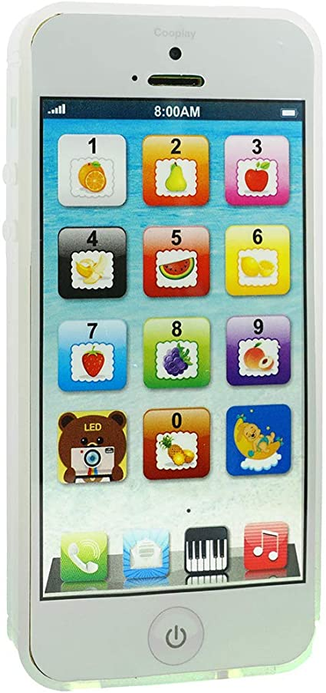
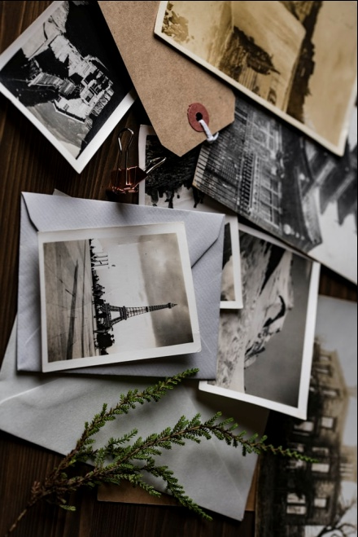
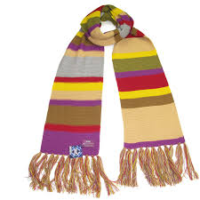
COMPLETE THE WORDS WITH F OR PH
_ _one
_ _ otos
scar_
al_ _ abet

Slide 7
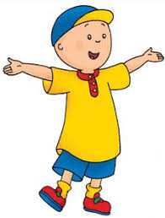
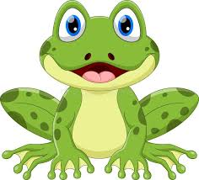
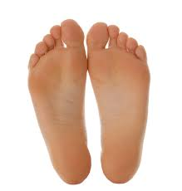
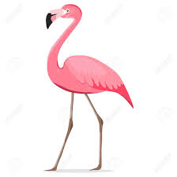
COMPLETE THE WORDS WITH F OR PH
_rog
ne_ _ew
_eet
_lamingo

